Slide 1

Perform the CRUD Operation(Post, Put, Get ,Delete) using Front-end(angular) and Back-end(SpringBoot).
Project Name : Medicine Dashboard
Group 2
Guide : Shiwani Kumbhalkar Ma’am
TC02022939 Vaishnavi Jadhav
TC02022905 Disha Rajendra Tamore
TC02022903 Ankita Omprakash Yadav
TC02022933 Simran Sanjay Sankhe
TC02022902 Aishwarya Rajesh Shinde
TC02022927 Priti Prem Ghodke
TC02022932 Shubhangi Ghorkhana
TC02022917 Novina Hareshwar Koli
CSR Initiative

Slide 2
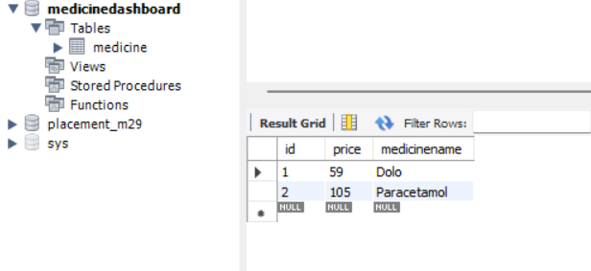
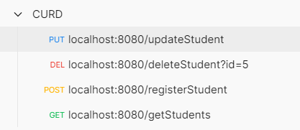
Backend
Tools
Eclipse IDE
MYSQL DB
POSTMAN
Technologies
Angular
TypeScript
Basic Bootstrap and HTML
Technologies
Spring Boot
JPA
Server (Embedded Tomcat)
Frontend
Tools
VS Code IDE
MYSQL
STS
Spring Boot for implementing a RESTful backend,
and Angular for creating a Java Base frontend.
We are creating spring starter web project in which we add dependencies which is required for project
MySQL
Give details of MySQL server in application.properties and url for project (URL=jdbc:mysql://localhost:3306/medicinedashboard)
spring.datasource.username=root
spring.datasource.password=Admin
Run the project and check whether data from SQL is fetched
Postman
Send data to SQL by using Postman and Spring Boot
CRUD operation implement
To Post : localhost:8080/registerMedicine
To retrieve data : localhost:8080/retrieveMedicine
To Delete data : localhost:8080/deleteMedicine/id=5
To Update data : localhost:8080/updateMedicine
MySQL
Postman
Postman

Slide 3
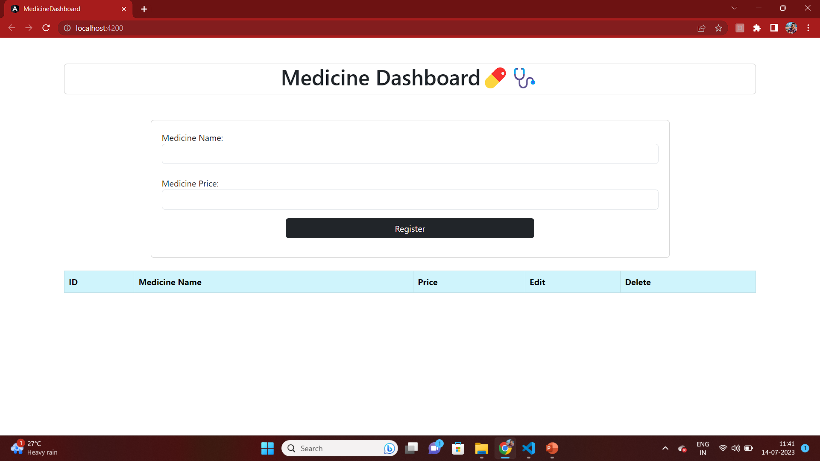
Front end Part of Medicine Dashboard
Angular and Visual Code
Front End Part development by using Angular and Visual Code
In this we create Medicine Dashboard workspace
In workspace Medicine service create by using command
ng g s <service name>
Create Angular Form to insert data by using app.component.html and app.component.ts
Following CRUD operation done by using Angular + STS
Select / retrieve data from data base
Fetch data and show to angular
Delete data from database using id
Delete data by button in angular
Update data in STS
Update or Edit student record using angular form
Angular

Slide 4
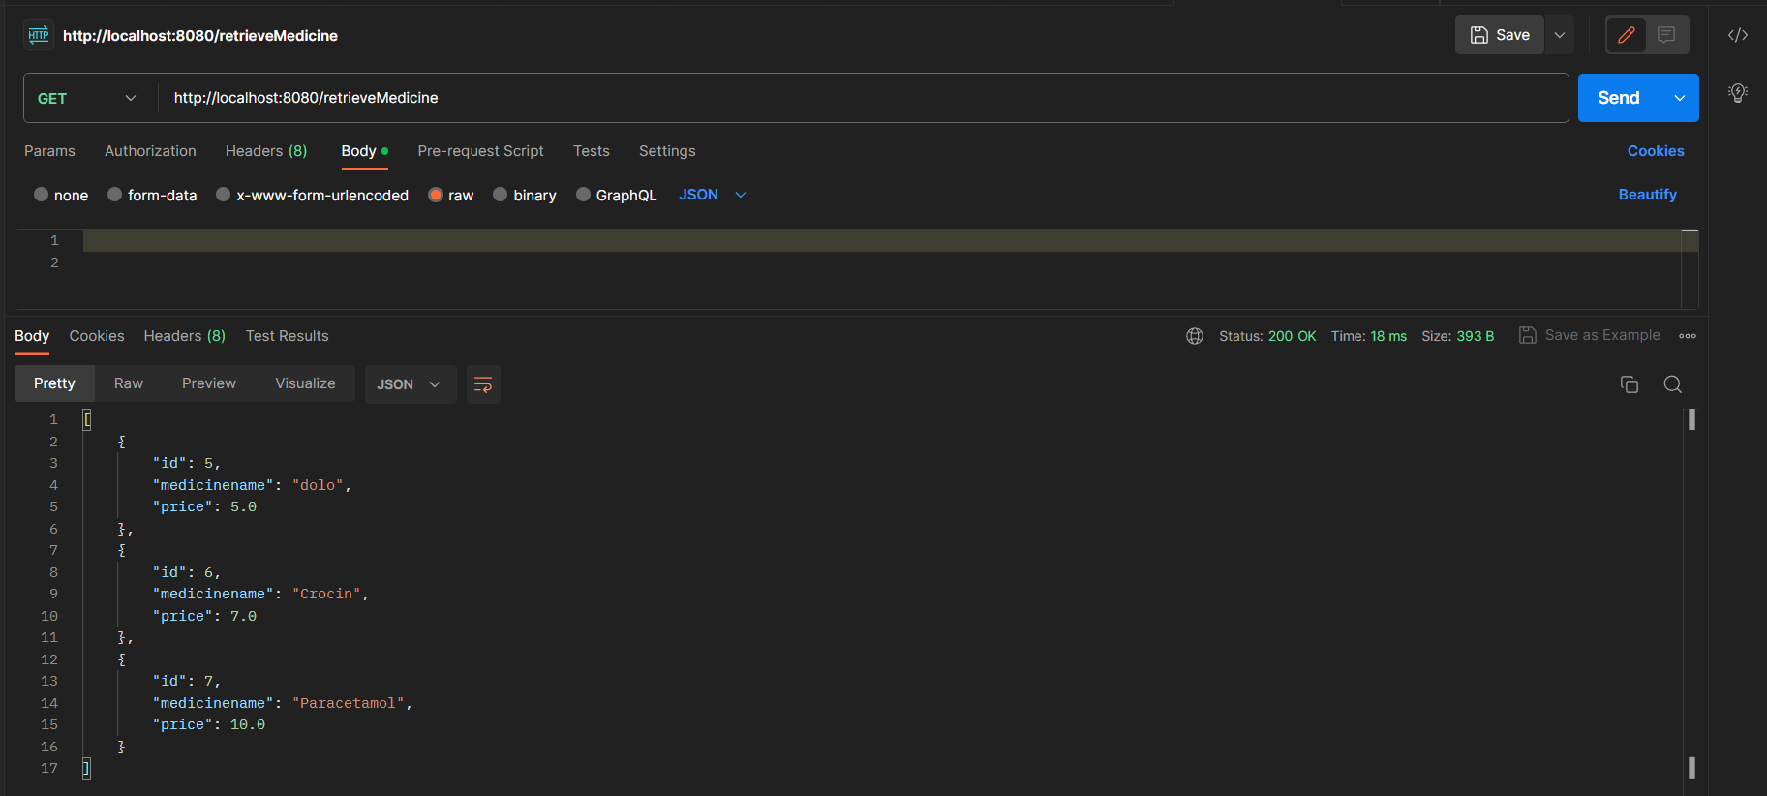
CRUD Operations Back end part using STS + Postman = MySQL
1. GET Method FOR MEDICINE DASH BOARD

Slide 5
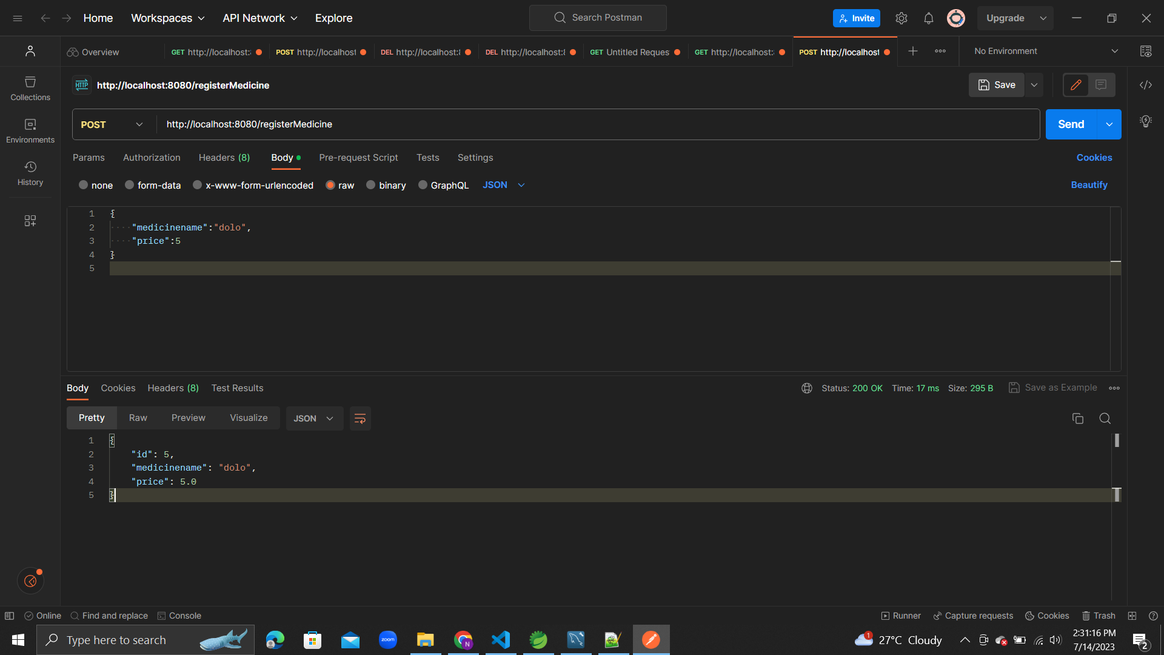
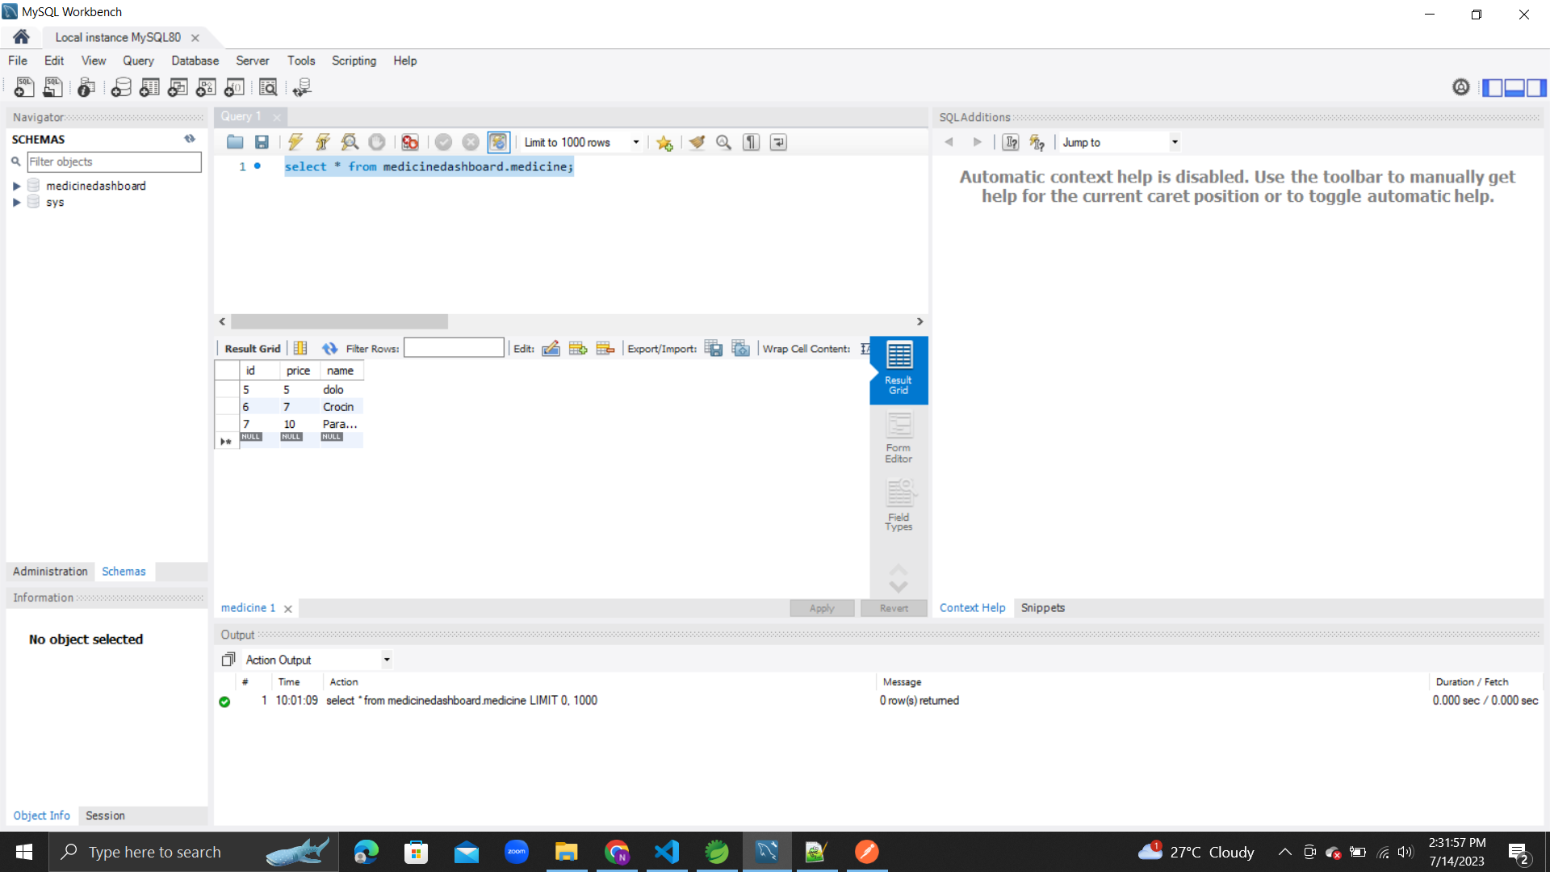
CRUD Operations Back end part using STS + Postman = MySQL
2. POST Method MEDICINE DASH BOARD

Slide 6
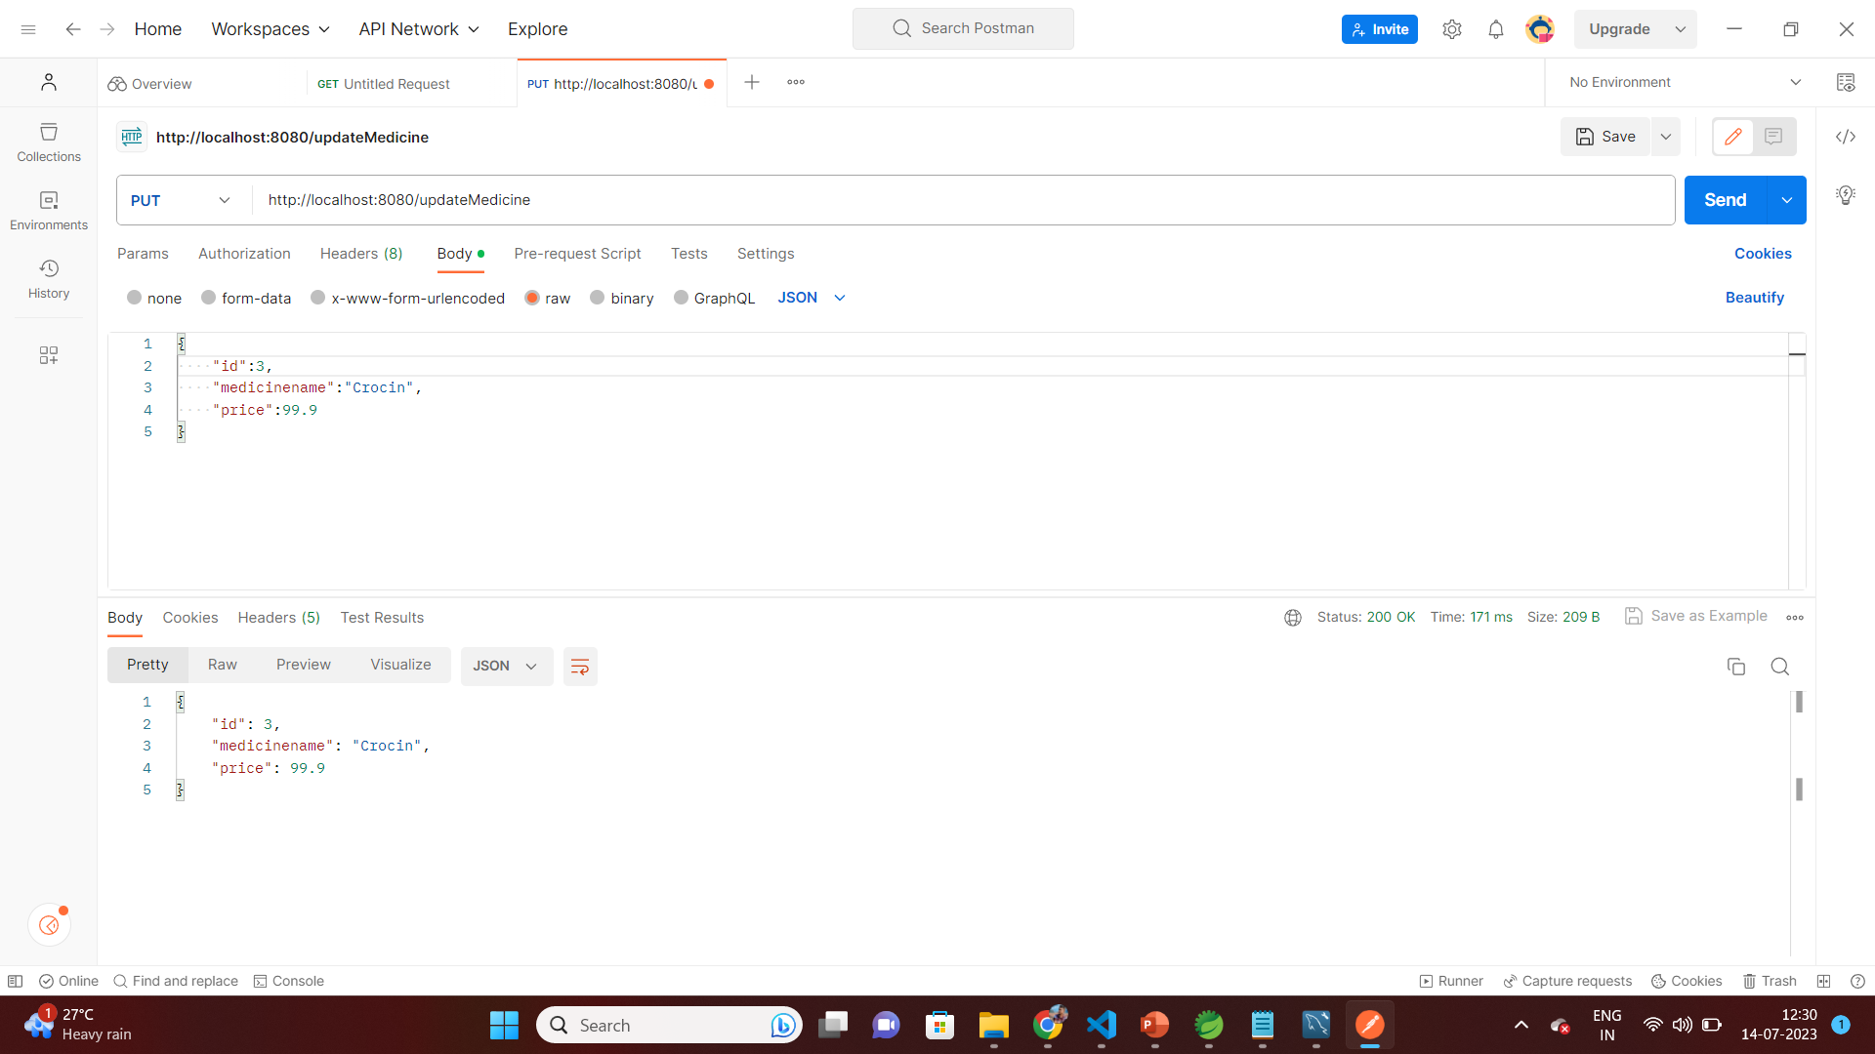
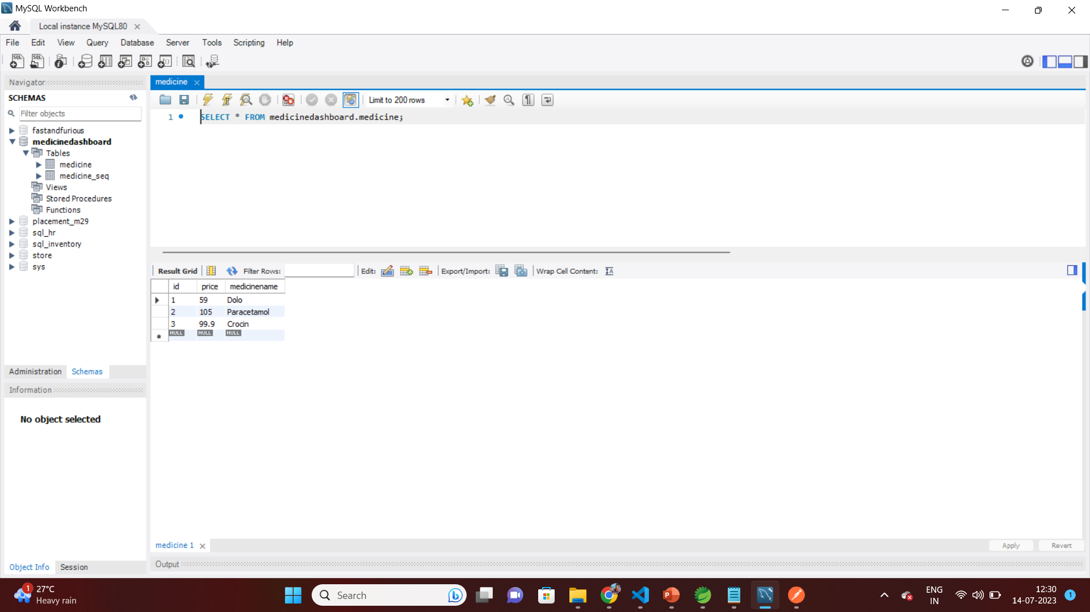
CRUD Operations Back end part using STS + Postman = MySQL
3. PUT Method MEDICINE DASH BOARD

Slide 7
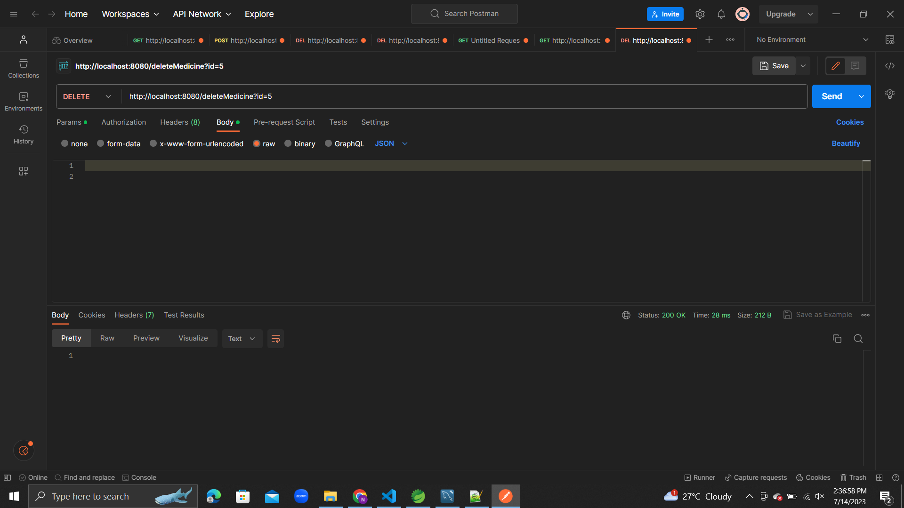

CRUD Operations Back end part using STS + Postman = MySQL
4. DELETE Method MEDICINE DASH BOARD

Slide 8
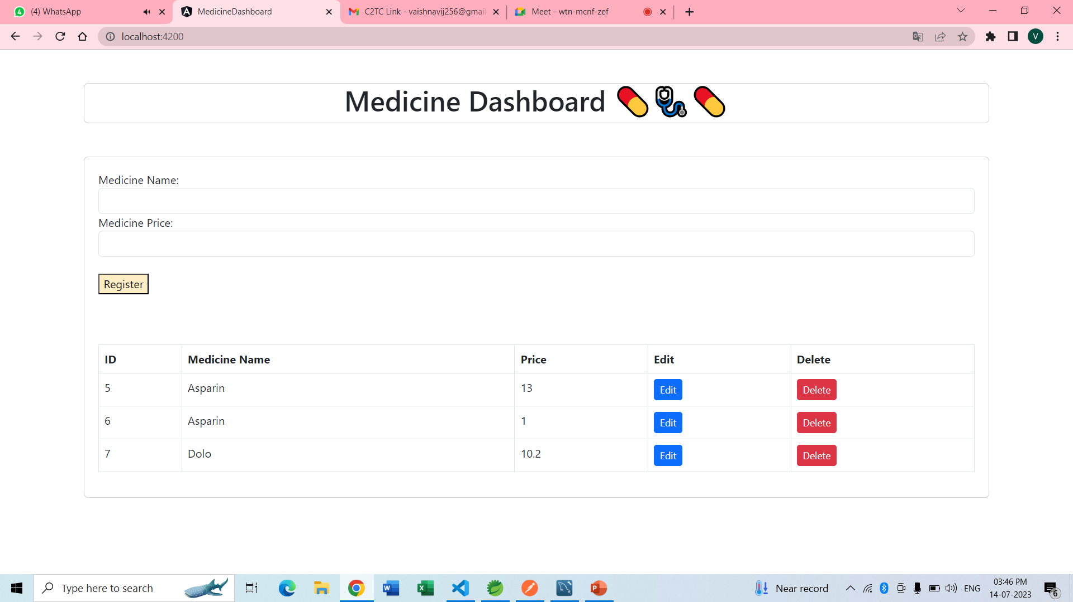
CRUD Operations
1. Create / Retrieve Data from Angular
Medicine information create in this table
Fill all information of medicine and hit register button

Slide 9
Conclusion
We have successfully completed Medicine dashboard application and its running locally. By using Angular it is easy to built the Medicine dashboard applications. Now we will work how to search this application in google search engine

Slide 10
Thank You

